Slide 1

PROJECT HUMAN RESOURCE MANAGEMENT

Slide 2
Project Human Resource Management
The Project Management Institute defines human resources management as the art and science of directing and coordinating human resources throughout the life of a project, by using administrative and behavioral knowledge to achieve predetermined project objectives of scope, cost, time, quality, and participant satisfaction.
This knowledge area includes the processes that organize, manage, and lead the project team

Slide 3
Project Human Resource Management
Project Team
  Project teams must be assembled to accomplish the work necessary to complete engineering and construction projects.
  Team members are vital to the success of the project. The project manager depends on the team because he or she typically does not have the expertise to do all the work required to complete the project.
  For any team, there must be a leader to guide the overall efforts.
  In many respects the project manager acts as a coach, answering questions, making sure the team understands the desired outcome of the project, and ensuring that team members know what is expected of them and the importance of sharing information.

Slide 4
Project Human Resource Management
Project teams are made up of all the participants in the project, including in-house personnel and outside consultants.
Team members report either part-time or full-time to the project manager and are responsible for some aspect of the project's activities.
Teamwork must be well coordinated with effective interaction to achieve the shared objective of completing the scope, budget, and schedule constraints of the project.
The project team is comprised of the people with assigned roles and responsibilities for completing the project.
Project team members may also be called project’s staff
Early involvement and participation of team members adds their expertise during the planning process and strengthens their commitment to the project

Slide 5
Project Human Resource Management
HRM Processes
  Develop Human Resource Plan
  Acquire Project Team
  Develop Project Team
  Manage Project Team

Slide 6
Develop Human Resource Plan
  It is the process of identifying and documenting project roles, responsibilities, and required skills, reporting relationships (project organization charts OBS), and creating a staffing management plan including the timetable for staff acquisition and release.

Slide 7
Develop Human Resource Plan
  It may also include identification of training needs, team-building strategies, plans for recognition and rewards programs, compliance considerations, safety issues, and the impact of the staffing management plan on the organization.
  Human resource planning is used to determine and identify human resources with the necessary skills required for project success

Slide 8
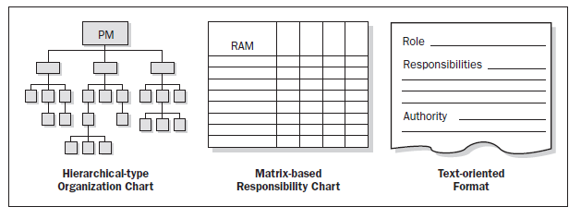
Develop Human Resource Plan
Tools & Techniques
  Organization Charts and Position Descriptions
  Various formats exist to document team member roles and responsibilities. Most of the formats fall into one of three types hierarchical, matrix, and text-oriented. Regardless of the method utilized, the objective is to ensure that each work package has an unambiguous owner and that all team members have a clear understanding of their roles and responsibilities.

Slide 9
Develop Human Resource Plan
Hierarchical-type charts
  The traditional organization chart structure can be used to show positions and relationships in a graphic, top-down format.
  Organizational breakdown structure (OBS) is arranged according to an organization’s existing departments, units, or teams.
  The arrangement of the individuals or a group of the individuals from the project team is done in such a way that they can be related to the work packages in the WBS.

Slide 10
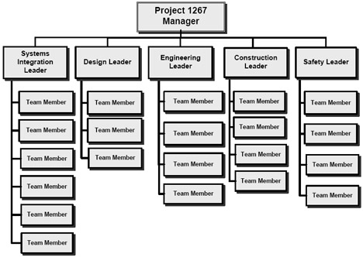
Develop Human Resource Plan
Project OBS

Slide 11
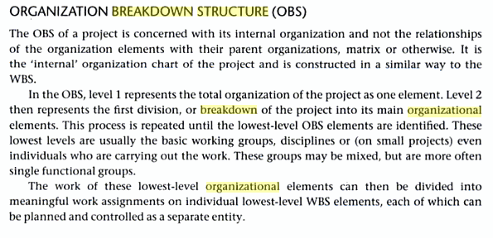
Develop Human Resource Plan

Slide 12
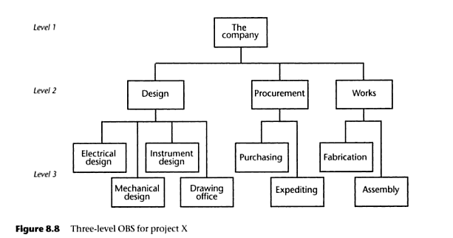
Develop Human Resource Plan

Slide 13
Develop Human Resource Plan
Matrix-based charts - A responsibility assignment matrix (RAM)
It is used to define connections between work packages or activities and project team members.
On larger projects, RAMs can be developed at various levels. For example, a high-level RAM can define what a project team group or unit is responsible for within each component of the WBS, while lower level RAMs are used within the group to designate roles, responsibilities, and levels of authority for specific activities.
The matrix format shows all activities associated with one person and all people associated with one activity.
This also ensures that there is only one person accountable for any one task to avoid confusion.

Slide 14
Develop Human Resource Plan
Text-oriented formats
  Team member responsibilities that require detailed descriptions can be specified in text-oriented formats.
  Usually in outline form, the documents provide information such as responsibilities, authority, competencies, and qualifications.
  The documents are known by various names including position descriptions and role-responsibility-authority forms.

Slide 15
Develop Human Resource Plan
Some of the outcomes include:
Human Resource Plan - It is a part of the project management plan, provides guidance on how project human resources should be defined, staffed, managed, controlled, and eventually released.
1. Roles and responsibilities. The following should be addressed when listing the roles and responsibilities needed to complete a project:
Role. The label describing the portion of a project for which a person is accountable. Examples of project roles are civil engineer, court liaison, business analyst, and testing coordinator. Role clarity concerning authority, responsibilities, and boundaries should be documented.

Slide 16
Develop Human Resource Plan
  Authority. The right to apply project resources, make decisions, and sign approvals. Examples of decisions that need clear authority include the selection of a method for completing an activity, quality acceptance, and how to respond to project variances. Team members operate best when their individual levels of authority match their individual responsibilities.
  Responsibility. The work that a project team member is expected to perform in order to complete the project’s activities.
  Competency. The skill and capacity required to complete project activities. If project team members do not possess required competencies, performance can be jeopardized. When such mismatches are identified, proactive responses such as training, hiring, schedule changes, or scope changes are initiated.

Slide 17
Develop Human Resource Plan
2. Project organization charts. A project organization chart is a graphic display of project team members and their reporting relationships.
3. Staffing Management Plan. The staffing management plan, a part of the human resources plan within the project management plan, describes when and how human resource requirements will be met. Some of the information included is:
  Staff acquisition (Where will they come from?)
  Resource calendars (When are people available? When will they be used?)
  Staff release plan (When will resources be released and no longer be charged to the project)
  Training needs (What training do the resources need?)
  Recognition and rewards (What are they? What are the criteria for their use?)
  Compliance (How will the project comply with any rules related to the human resources? Government, State or local policies (e.g. Ministry of labor))
  Safety (What policies protect the resources?)

Slide 18

Acquire Project Team
It is the process of confirming human resource availability and obtaining the team necessary to complete project assignments
It is important that the following factors are considered during the acquisition of the project team
  The project manager or project management team should effectively negotiate and influence others who are in a position to provide the required human resources for the project

Slide 19
Acquire Project Team
  Failure to acquire the necessary human resources for the project may affect project schedules, budgets, customer satisfaction, quality, and risks. It could decrease the probability of success and ultimately result in project cancellation
  If the human resources are not available due to constraints, economic factors or previous commitments to other assignments to other projects, the project manager or project team may be required to assign alternative resources, perhaps with lower competencies, provided there is no violation of legal or other specific criteria

Slide 20
Acquire Project Team (Tools & Techniques)
Pre-Assignment
  When project team members are selected in advance they are considered pre-assigned. This situation can occur if the project is the result of specific people being promised as part of a competitive proposal, if the project is dependent upon the expertise of particular persons, or if some staff assignments are defined within the project charter.
Negotiation
  Staff assignments are negotiated on many projects. For example, the project management team may need to negotiate with:
    Functional managers to ensure that the project receives appropriately competent staff in the required time frame, and that the project team members will be able, willing, and authorized to work on the project until their responsibilities are completed,
    Other project management teams within the performing organization to appropriately assign scarce or specialized human resources

Slide 21
Acquire Project Team (Tools & Techniques)
    External organizations vendors, suppliers, contractors, etc., for appropriate, scarce, specialized, qualified, certified, or other such specified human resources.
Acquisition
  When the performing organization lacks the in-house staff needed to complete a project, the required services may be acquired from outside sources. This can involve hiring individual consultants or subcontracting work to another organization.

Slide 22
Acquire Project Team
Some of the outcomes include:
  Project Staff Assignments
    The project is staffed when appropriate people have been assigned through methods like pre-assignment, negotiation and acquisition etc. The documentation of these assignments include a project team directory, memos to team members, and names inserted in to other parts of the project management plan, such as project organization charts and schedules
  Resource Calendars
    It documents the time periods that each project team member can work on the project.

Slide 23
Develop Project Team
It is the process of improving the competencies, team interaction, and the overall team environment to enhance project performance
Project Managers should acquire skills to identify, build, maintain, motivate, lead, and inspire project teams to achieve high team performance and to meet the project’s objectives

Slide 24
Develop Project Team
Teamwork is a critical factor for project success, and developing effective project teams is one of the primary responsibilities of the project manager. Project managers should create an environment that facilitates teamwork. Project managers should continually motivate their team by providing challenges and opportunities, by providing timely feedback and support as needed, and by recognizing and rewarding good performance. High team performance can be achieved by using open and effective communication, developing trust among team members, managing conflicts in a constructive manner, and encouraging collaborative problem-solving and decision-making. The project manager should request management support and/or influence the appropriate stakeholders to acquire the resources needed to develop effective project teams.

Slide 25
Develop Project Team (Tools & Techniques)
Interpersonal skills
  These are sometimes known as “soft skills,” and are particularly important to team development. The project management team can greatly reduce problems and increase cooperation by understanding the sentiments of project team members, anticipating their actions, acknowledging their concerns, and following up on their issues. Skills such as empathy, influence, creativity, and group facilitation are valuable assets when managing the project team.
Training
  Training includes all activities designed to enhance the competencies of the project team members. Examples of training methods include classroom, online, computer based, on-the-job training from another project team member, mentoring, and coaching. If project team members lack necessary management or technical skills, such skills can be developed as part of the project work.

Slide 26

Develop Project Team (Tools & Techniques)
Recognition and Rewards
  Part of the team development process involves recognizing and rewarding desirable behavior. It is important to recognize that a particular reward given to any individual will only be effective if it satisfies a need which is valued by that individual. Only desirable behavior should be rewarded. For example, the willingness to work overtime to meet an aggressive schedule objective should be rewarded or recognized; needing to work overtime as the result of poor planning by the team member should not be rewarded. People are motivated if they feel they are valued in the organization and this value is demonstrated by the rewards given to them.
Co-location
  Co-location involves placing many or all of the most active project team members in the same physical location to enhance their ability to perform as a team.

Slide 27
Develop Project Team
Some of the outcomes include:
Team Performance assessments
As the project team development efforts such as training, team building, and co-location are implemented, the project management team makes formal or informal assessments of the project team’s effectiveness.
The performance of a successful team is measured in terms of technical success according to agreed-upon project objectives, performance on project schedule (finished on time), and performance on budget (finished within financial constraints). High-performance teams are characterized by these task-oriented and results-oriented outcomes.
Effective team development strategies and activities are expected to increase the team’s performance

Slide 28
Manage Project Team
It is the process of tracking team member performance, providing feedback, resolving issues, and managing changes to optimize project performance
The project management team observes team behavior, manages conflict, resolves issues, and appraises team member performance

Slide 29
Manage Project Team
Team management involves a combination of skills with special emphasis on communication, conflict management, negotiation, and leadership
Project managers should provide challenging assignments to team members and provide recognition for high performance

